Slide 1

Longitudinal Multilevel Models
Houston F. Lester

Slide 2
Outline
Introduction to longitudinal analysis: 9 – 10:30*
General idea
More detail
Getting the pattern of change over time correct: 10:45 – 12:15*
Change versus Fluctuation
Time-invariant predictors
Getting the pattern of change over time correct: 1:00 – 2:30*
Change versus Fluctuation
Time-invariant predictors
Adding predictors after getting the pattern of change over time right 2:45 – 4:15*
Time-varying predictors
Full length data analysis example
*Last 15-30 minutes of each session will be working with R code

Slide 3
Todays Objectives
Present the terminology of longitudinal/multilevel models
Give you tools to answer your own questions regarding longitudinal data
Discuss and perform basic multilevel models and build toward complex models in R
Empty models (no predictors), means and slopes as outcomes, cross-level interactions, models for growth, and models for fluctuation
Introduce time invariant and time-varying predictors
Relevant data management will also be performed in R

Slide 4
Definition and why these models are worth learning
Longitudinal data definition – multiple observations from the same unit
Time scale can be very different from one study to the next (milliseconds to decades)
Two is the minimum number of time points, but more is better
Why use these models as opposed to repeated measures ANOVA?
Multilevel model provides methodological middle-ground between two repeated measures ANOVA modeling alternatives (univariate approach and multivariate approach)
Univariate very simple (few parameters estimated), multivariate is very complex (all possible variance/covariance parameters estimated)

Slide 5
Multilevel Models (MLM)
Multilevel models handle missing data better
Partially complete outcome data are used in the analysis
People don’t have to be measured at the same times (unbalanced time can be accommodated)
In repeated measures ANOVA – data are assumed to be missing completely at random – probability of missing data is unrelated to all variables
Multilevel models assume the data are missing at random – probability of missing data are related to variables but not the values of Y itself

Slide 6
What does MLM do?
Model that accounts for hierarchical nesting
Examples of hierarchical nesting
Person nested within group (e.g., team, company, school)
This is what people typically think of as multilevel
Time nested within person (longitudinal data analysis)
Can also have time nested within person that is nested within group (3-level)
Estimates a model for multiple levels of analysis simultaneously

Slide 7
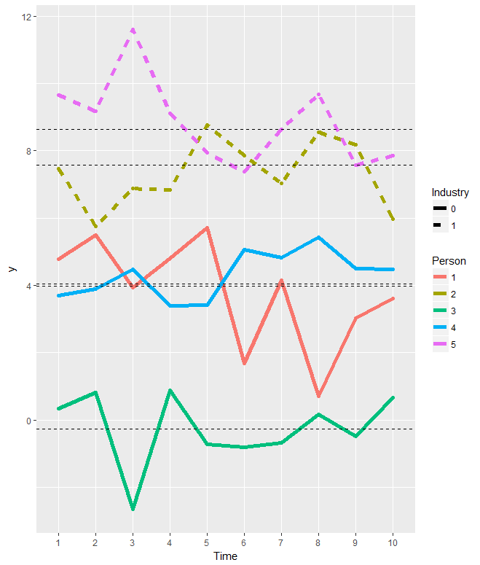
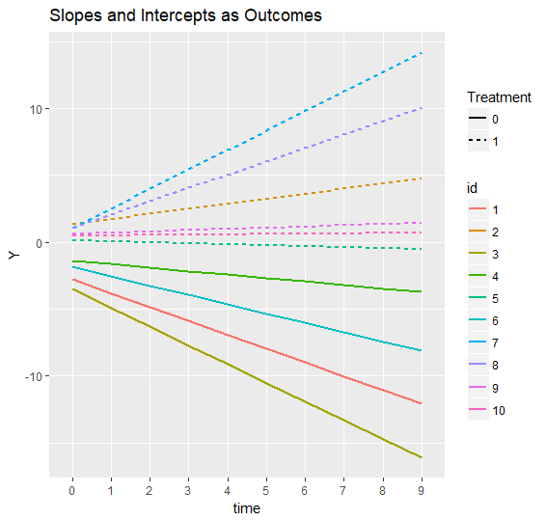
Longitudinal Data
Question 1: Does your outcome variable actually vary over time?
ICC(1) – Between/(Between + Within)
Question 2: Do you expect your outcome to be more about fluctuation or change?

Slide 8
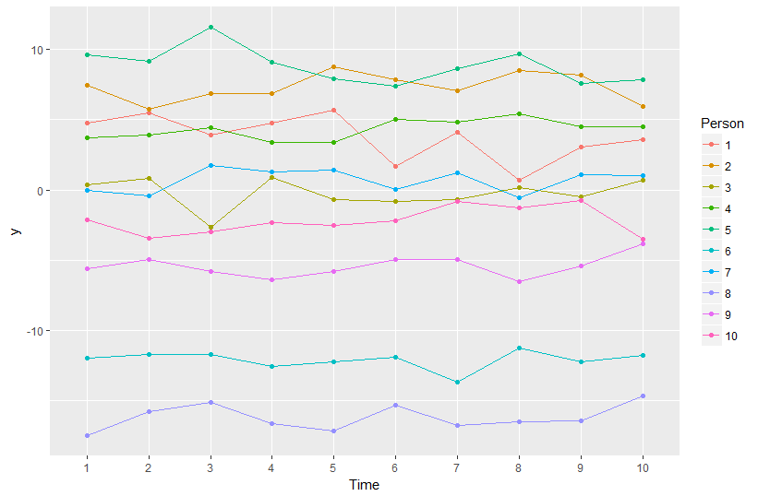
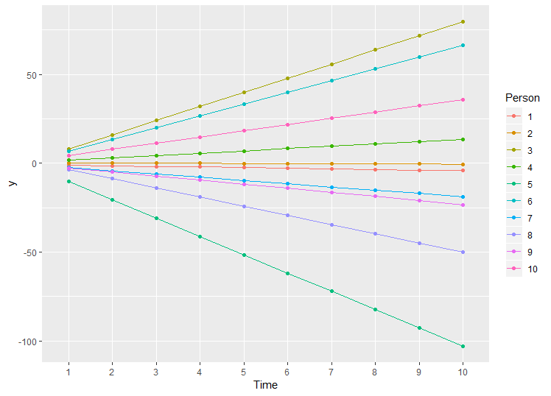
Two Flavors of Longitudinal Data Analysis
Models for fluctuation
Models for Change

Slide 9
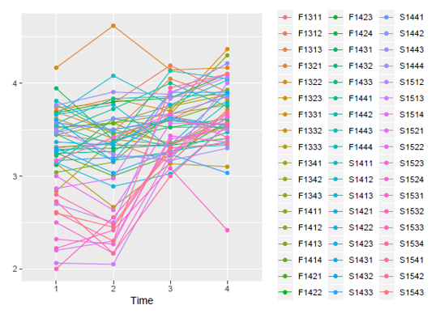
More Realistic Plot

Slide 10
Longitudinal Issues
There are two major issues that make longitudinal multilevel modeling from more complicated than cross-sectional multilevel modeling
1. You have to model change over time or the lack thereof appropriately before adding in any predictors (other than time)
2. The model for the variances becomes more important
Time points are identifiable and likely not to be exchangeable (time points 1 and 2 are likely to be more correlated than time points 1 and 7). Your modeling should reflect that.
What you expect regarding the pattern of change over time will help you determine how many time points you need

Slide 11
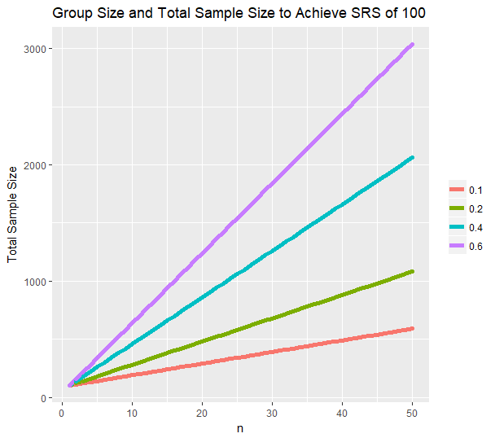
Consequences of Dependency

Slide 12
Terminology
Between/within person or unit
Level 1 or within-person is the “lower” level referred to as intra-individual difference or time-varying (Level-1/ intra-individual/time-varying)
Level 2 or between-person is the “higher” level referred to as inter-individual differences or time-invariant (Level-2/ inter-individual/time-invariant)
Outcome typically (almost always) measured at level-1
Predictors may occur at either level
Time-varying (e.g., daily stress measurements; job satisfaction)
Time invariant (e.g., Demographic sorts of variables (department; biological sex); person average stress)
Hierarchically nested has nothing to do with hierarchical regression

Slide 13
The Two Sides of Any Model
Model for the Means
Fixed effects – the portion of the model that is most commonly used to test hypotheses
How the expected outcome (predicted value or conditional mean) varies as a function of the predictor variables
Model for the Variance
Random effects and residuals, stochastic part of the model
Typically assumptions are made regarding this portion of the model
Primary way multilevel models differ from traditional regression

Slide 14
Typical Longitudinal MLM Research Questions
1. Is there significant between person variability?
Can be used to determine if you need to do a multilevel model
2. What proportion of the variability is between/within person?
ICC= Between_{var}/(Between_{var} + Within_{var})
3. On average, is the time-varying effect of the predictor and outcome significant?
Do people tend to become more or less stressed over time?
4. Does the effect of the level-1 predictor vary across the level-2 unit (person; i.e., random slope of level-1 predictor)?
Do some people become more stress over time while others do not?
5. Are adjacent time points more related to one another than more distant occasions?

Slide 15
Longitudinal RQ’s cont.
6. Does a level-two variable explain between-person variability?
Variables can only explain variability at same level of analysis
Are males more or less stressed than females on average?
7. Does the level-one effect depend upon other level-two predictors (cross-level interaction)?
Does the treatment group (assuming time-invariant treatment assignment) become less stressed while the control stays the same
8. Does the between-person effect equal the within-person effect of the same predictor?
Is there an incremental effect of being person that has a mean on the predictor (i.e., contextual effect)

Slide 16
Introducing MLMs focus on model for the Means
Typical Ordinary least squares regression
MLM can be written as ; these sorts of models are referred to as unconditional models
Level 1 Model
Level 2 Model
y_{ti} is the outcome value for timepoint t from individual i
Β_{0i} is the intercept for person i
γ₀₀ is the grand mean (because there are no predictors)
u_{0i} is a person’s deviation from the grand mean
r_{ti} is the residual for occasion t from individual i

Slide 17
Variance side of the model
RQ 1. Is there significant between group variability?
RQ 2. What proportion of the variability is between/within group?
Regression model
Multilevel model

Slide 18
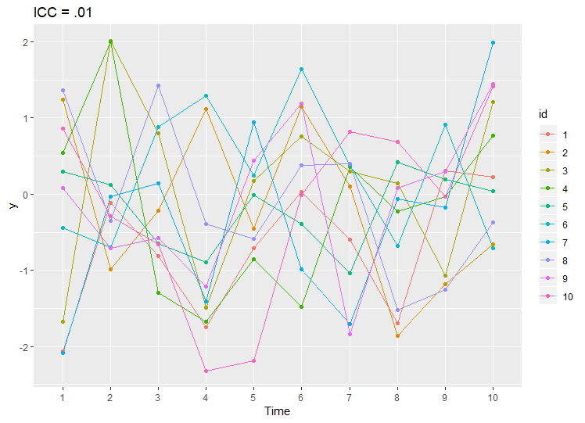
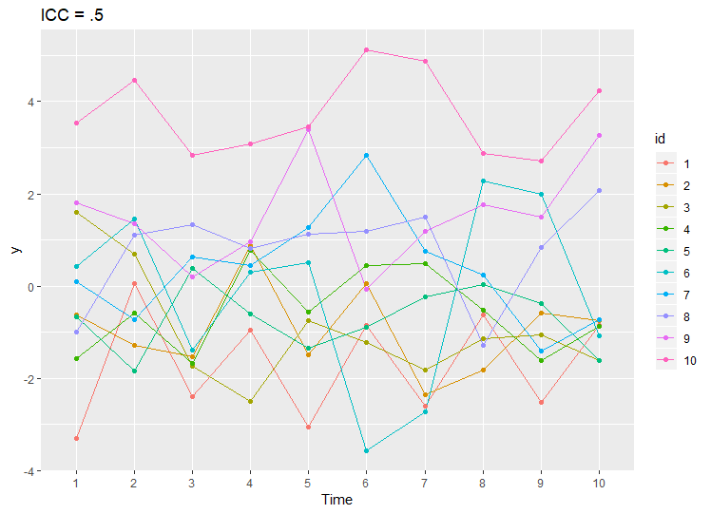
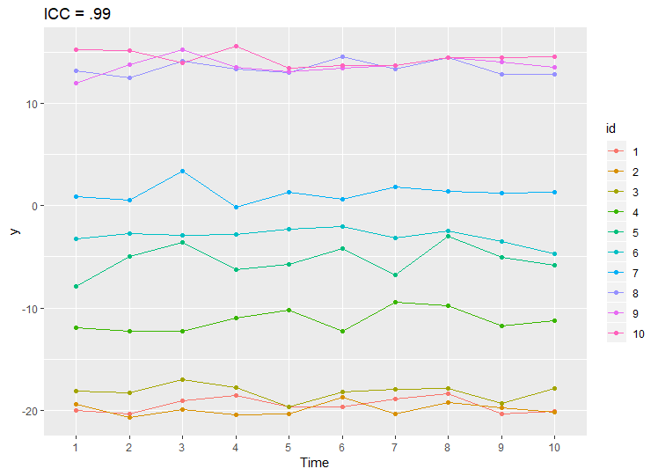
Ideas in Figures

Slide 19
Matrices of Random Effects
Matrices that describe the variances and covariances of the random effects
Level – 2 random effect variance and covariances are placed into the G matrix;
Level-1 random effect variance and covariances are in the R matrix
Combined to form

Slide 20
Installing and Setting up R and RStudio
Installing R
Windows
https://cran.r-project.org/bin/windows/base/
Mac
Open an internet browser and go to www.r-project.org.
Click the "download R" link in the middle of the page under "Getting Started."
Select a CRAN location (a mirror site) and click the corresponding link.
Click on the "Download R for (Mac) OS X" link at the top of the page.
Click on the file containing the latest version of R under "Files."
Save the .pkg file, double-click it to open, and follow the installation instructions.
Now that R is installed, you need to download and install RStudio.

Slide 21
RStudio download
https://www.rstudio.com/products/rstudio/download/
Scroll a bit and select your operating system

Slide 22
Getting a feel for R
Let’s do some data management
Provide a bit of information about the data structure in R as well.
Please open the “DataManagement.R”

Slide 23
Unconditional Models
Unconditional models are models that do not involve predictors other than time
Focus is on getting the random side of the model right before adding in the predictors of interest
Two different sorts of data – within-person variation and within-person change
Start with within-person change

Slide 24
Unconditional Change models
RQ 3. On average, is the time-varying effect of the predictor and outcome significant?
RQ 4. Does the effect of the level-1 predictor vary across the level-2 unit?
We do expect some improvement over time
Either natural development or an intervention has been performed

Slide 25
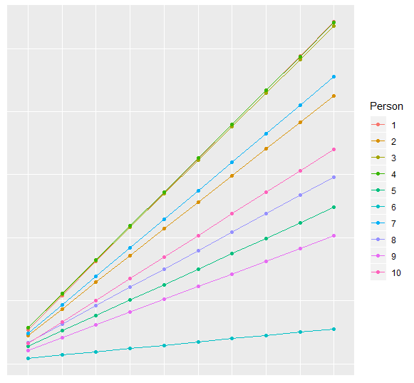
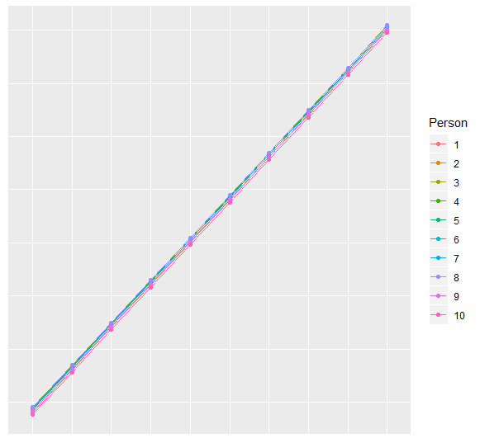
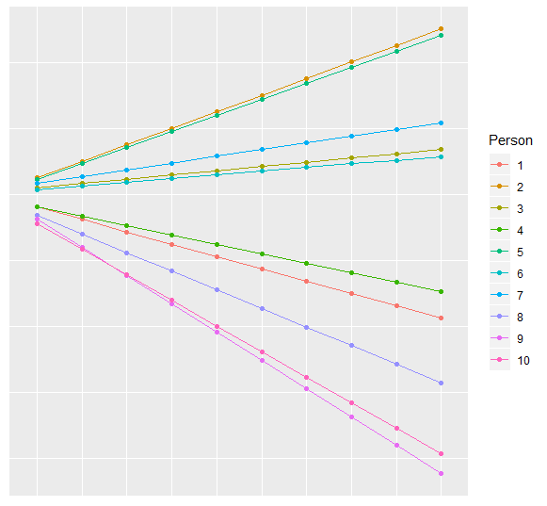
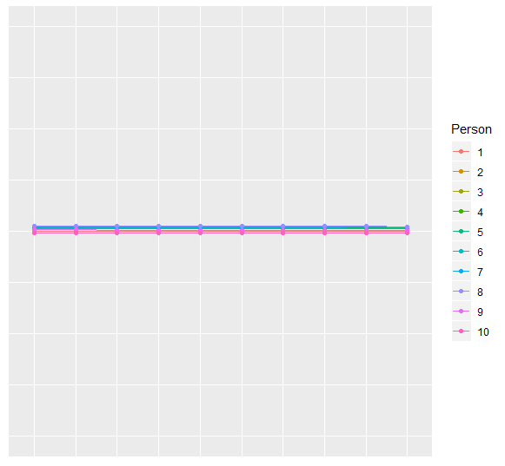
Slide for showing the different sorts of change
Fixed and Random
Fixed without Random
No Fixed and Random
No Fixed, No random

Slide 26
Practical Considerations
The type of change that you expect over time determines the number of time points that you need
If you know that your data demonstrate linear growth, then you only really need three time points.
However, I have been wrong once☺
The more curvy the trend over time, the more time points you need
Polynomials, piecewise, and other alternatives
Empty Model
Saturated Model
Parsimony
Good Fit

Slide 27
Unconditional Models
Mixed Model
Level-1 Model
Level-2 Model
y_{ti} is the outcome value for timepoint t from individual i
Β_{0i} is the intercept for person i
B_{1i} is the slope for person i
γ₀₀ is the predicted mean for at time point 0
γ₁₀ is the fixed slope for time
u_{0i} is a person’s deviation from the grand mean
u_{1i} is a person’s deviation from the grand mean
e_{ti} is the residual for occasion t from individual i
Notes:
Naming conventions

Slide 28
Random effects structure for Random Linear

Slide 29
Different sorts of change
Polynomials
Splines with theoretically chosen breakpoint
Other nonlinear options
Exponential models, s-shaped functions (e.g., Richards, Gompertz, and Logistic)
Exploratory or non-parametric options

Slide 30
Polynomials
Level-1: Linear
Level-1: Quadratic
Level-1: Cubic
Level 2 Equations for Quadratic
Highest-order polynomial possible depends upon number of time points you have
n – 1 fixed
n – 2 random
4 time points is sufficient to get complicated (cubic fixed and quadratic random)

Slide 31
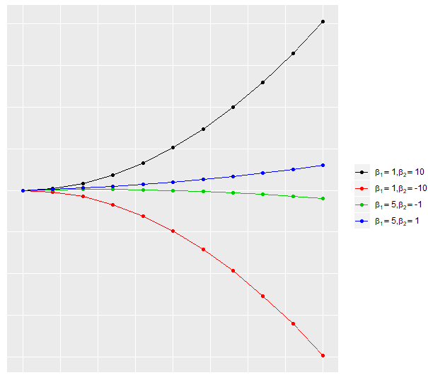
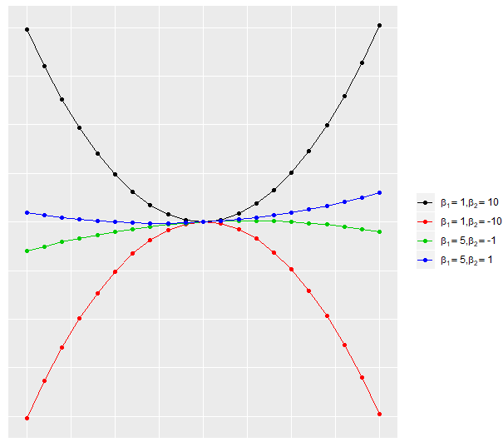
Pictures of Polynomials

Slide 32
Interpreting Polynomials
Brief Review of interpreting interaction terms in general
Interaction and moderation are almost always used synonymously
The effect of the predictor depends upon the level of the moderator
Either variable could be thought of as the moderator – decision driven by theory
Interactions in longitudinal data analysis often involve time
The effect of time (i.e., the amount of improvement over time) depends upon on the moderator (e.g., treatment status)
Specifically, β₁ is the effect of x specifically when the moderator is 0

Slide 33
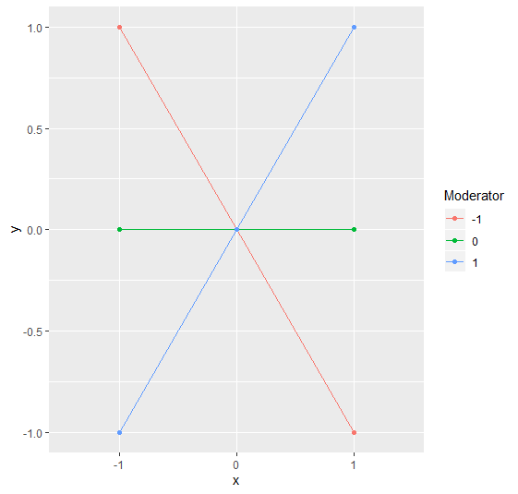
Interpreting Interactions

Slide 34
Back to Interpreting Polynomials
Linear – constant amount of change over time
Quadratic – change in the linear rate of change
Cubic – change in the acceleration (known as jerk is physics)

Slide 35
Interpreting Polynomial Fixed Effects
Lower order terms are conditional on higher order terms
Fixed Intercept only (γ₀₀ is the predicted mean of y for any occasion, grand mean)
Fixed linear time (γ₀₀ is the predicted mean of y at time 0)
γ₁₀ is the mean linear rate of change over time
Fixed quadratic time (γ₀₀ is the predicted mean of y at time 0)
γ₁₀ is the linear rate of change specifically at time = 0
γ₂₀ is half the mean rate of acceleration/deceleration of change across all occasions (i.e., the linear slope changes the same over time

Slide 36
Interpreting Polynomial Random Effects
Polynomial random effects – individual deviations from the fixed effect)
Can have up to number of time points minus two random effects
Random intercept variance = between unit variance in level (at time = 0)
Random slope of time variance = between unit variance in linear slope (at time 0)
Random Quadratic of time variance = between unit variance in quadratic slope

Slide 37
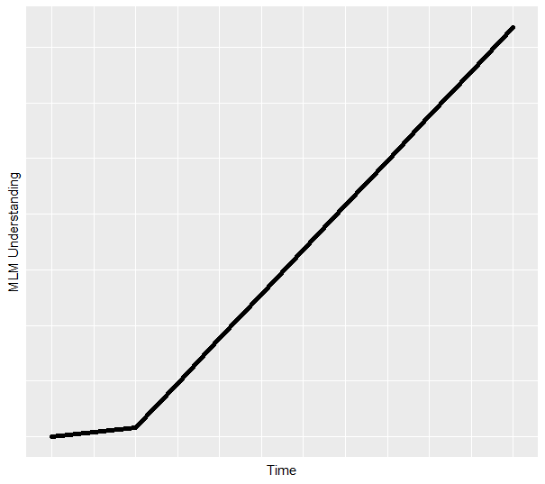
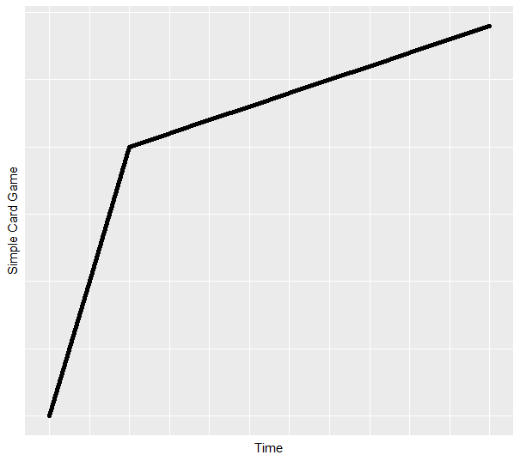
Piecewise Models
The overall trend over time is broken apart into multiple pieces

Slide 38
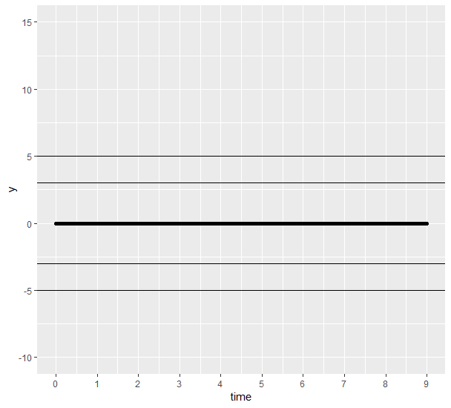
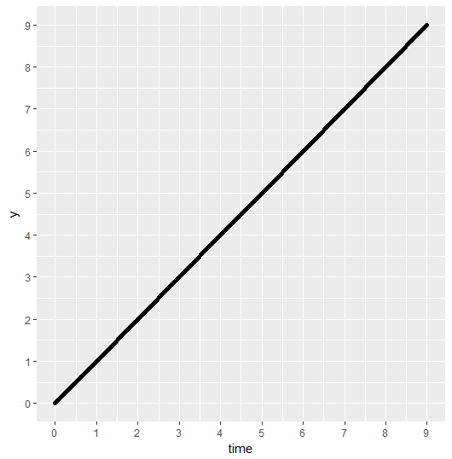
Modeling time – assuming growth step by step
Level 1 Model
Level 1 Model
Level 2 Model
Level 2 Model
The model on the right is normally the starting point

Slide 39
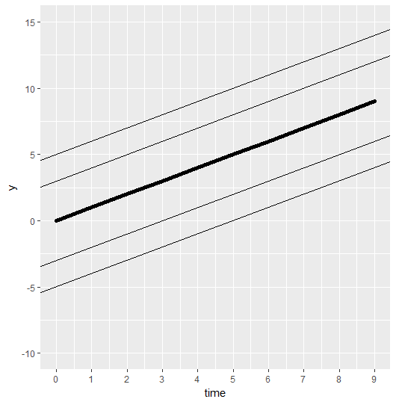
Random Intercept model
Level 1 Model
Level 2 Model

Slide 40
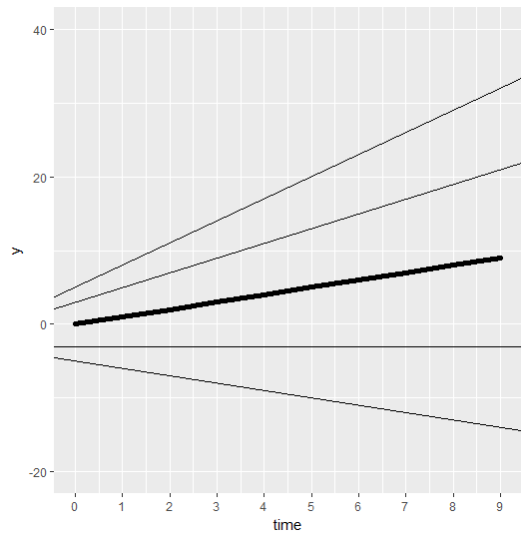
Random Linear Slope Model
Level 1 Model
Level 2 Model

Slide 41
Conditional Models
RQ 6. Does a level-two variable explain between-person variability?
RQ 7. Does the level-one effect depend upon other level-two predictors (cross-level interaction)?
Two types of predictor variables
Time-invariant – not much different than normal
Time-varying more complicated and more interesting than normal
Level 1 Model
Level 2 Model

Slide 42
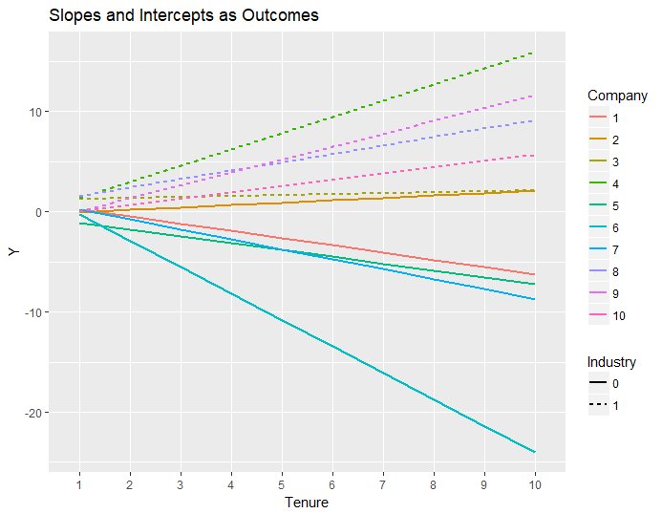
Slopes as outcomes
What explains variability between the means of the different people (Intercepts as outcomes)?
Industry 1 has higher Y
What explains variability in the random slopes?
Once again, industry 1 has larger (more positive) slopes

Slide 43
Let’s Do some of these
Open up the “UnconditionalChangeModels.R” file
How to proceed - for all outcomes
Empty model; calculate ICC
Decide on a metric of time
Decide on a centering point of time
Estimate means model and plot individual trajectories
If your outcome does show systematic change
5. Evaluate fixed and random effects of time
6. Consider alternative covariance matrices for with person/unity dependency (R matrix)
If your outcome does not show systematic change
5. Evaluate alternative models for the Variances

Slide 44
Within-person Fluctuation
Example data types
Ecological momentary assessments
Daily diary
Within-person process sorts of analyses
Cases where you would not expect growth

Slide 45
Repeated Measures ANOVA
Provides the extremes in terms of the variance/covariance structure (very simple with few parameters estimated and very complex)
Compound Symmetry
Unstructured
Parsimony
Good Fit

Slide 46
Model Comparisons
Three decision points
Are the models nested?
Nested can have significance tests
Non-nested only allows for information criteria
Do the models differ in the means, variances, or both
Means? Can use ML -2LL tests to compare (or p-values of fixed effects)
Variances? Can only use -2LL tests to compare (don’t use the p-values provided directly on the output)
Both sides? Can only use ML – 2LL tests to compare
Are models estimated using ML or REML?
ML: All model comparisons are okay
REML : Model comparisons okay for the variance parameters only
http://www.lesahoffman.com/PSYC945/945_Lecture1_MLM_Review.pdf
Slides 78 - 82

Slide 47
Alternative Covariance Structures
Model comparisons
If not nested, models can always be compared using information criteria
AIC = Akaike IC = -2LL + 2 x n_{pars}
BIC = Bayesian IC = -2LL + log(N_{L2}) x n_{pars}
Two ways to create alternative covariance structures
Level-1 or R matrix only
A combination of the Level-2 (G matrix) and the R matrix

Slide 48
R-only ACS Models: AR1/ARH1
RQ 5. Are adjacent time points more related to one another than more distant occasions?
1st order Auto-Regressive
1st order Auto-Regressive Heterogeneous
Banded or Toeplitz
Banded or Toeplitz Heterogeneous

Slide 49
G and R Alternative Covariance Structures
Dependence due to constant between person differences is removed
G = τ₀₀
Then the alternative covariance structures from the previous slide are fit to the remaining residual dependency

Slide 50
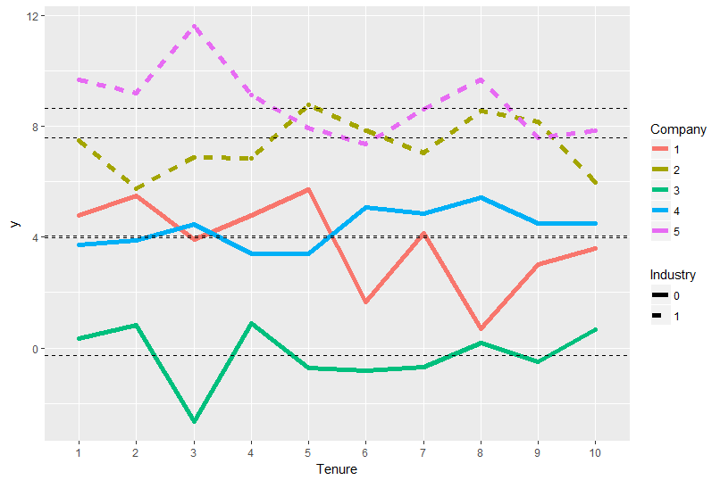
Intercepts as outcomes
RQ 3: Does a level two variable (Industry) explain between group variability?
What explains variability between the means of the different people (Intercepts as outcomes)?
Industry 1 has higher Y

Slide 51
Let’s Do some of these
Open the “UnconditionalFluctuation.R” file
How to proceed - for all outcomes
Empty model; calculate ICC
Decide on a metric of time
Decide on a centering point of time
Estimate means model and plot individual trajectories
If your outcome does show systematic change
5. Evaluate fixed and random effects of time
6. Consider alternative covariance matrices for with person/unity dependency (R matrix)
If your outcome does not show systematic change
5. Evaluate alternative models for the Variances

Slide 52
Multiple Effects for Each Level 1 Predictor
Between effect – are higher average predictor values associated with higher average outcome values
Within – if you are high relative to your own average, is your outcome also higher than your own average
Contextual effect – controlling for the level 1 predictor, is there an incremental effect of having a high mean
Difference between the between and within effects

Slide 53
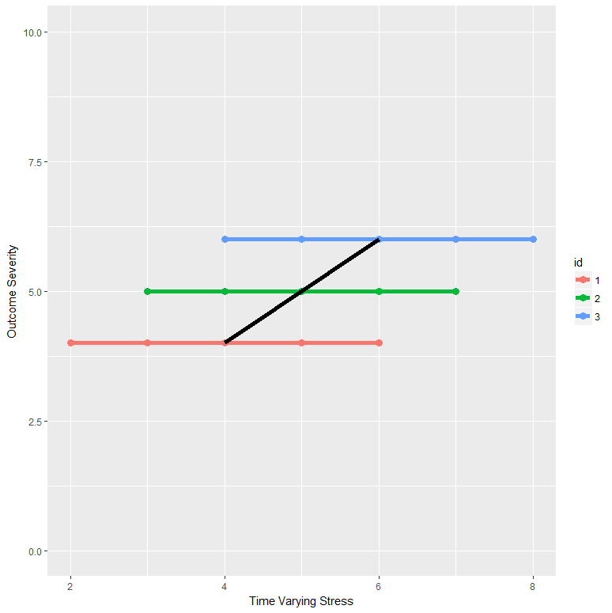
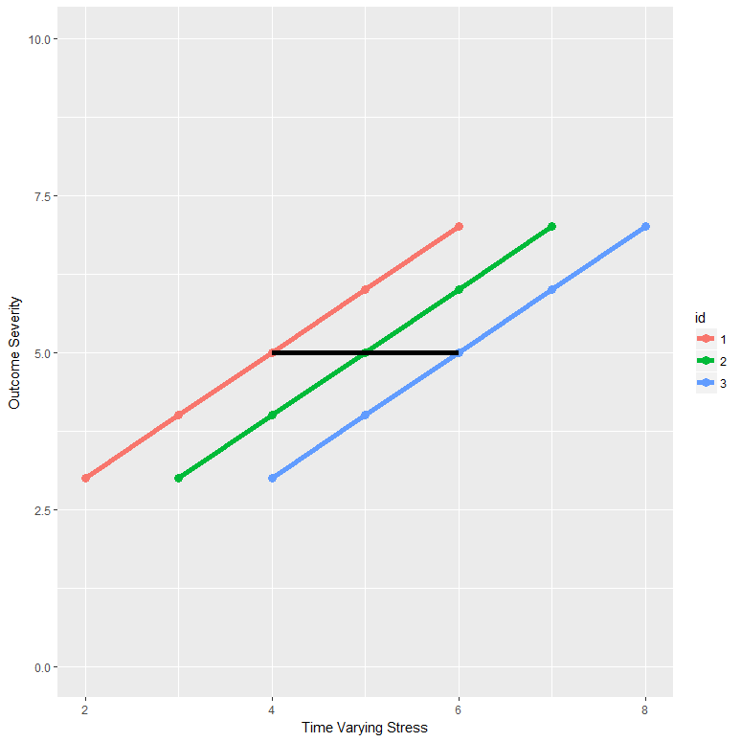
Between, Within, and Contextual Effects
Between = 1, Within = 0, Context = 1
Between = 0, Within = 1, Context = -1
TV Stress Mean (TVSM) = 4, TVSM = 5, ID = 3, TVMS = 6
Same means as before

Slide 54
RQ 8
8. Does the between-group effect equal the within-group effect of the same predictor?
Is there an incremental effect of being in a group that has a high group mean on the predictor (i.e., contextual effect)

Slide 55
Two different centering approaches
Group mean centering and grand mean centering
Either version of centering obtains two of the three effects directly
Group mean centering – gets you the between and within
Grand mean centering – gets you the within and the contextual effect
Group mean centering Grand mean centering

Slide 56
Putting everything together
Real data taken from Bliese and Ployhart (2002)

Slide 57
Additional Resources
Lesa Hoffman for longitudinal stuff http://www.lesahoffman.com/Courses.html
Donald Hedeker for mixed-effect location-scale stuff (not Bayesian and cannot estimate all versions of the models that you may be interested in)
brms for Bayesian estimation of the mixed-effect location scale
Bürkner P. C. (2017). brms: An R Package for Bayesian Multilevel Models using Stan. Journal of Statistical Software. 80(1), 1-28. doi:10.18637/jss.v080.i01
Bürkner P. C. (2018). Advanced Bayesian Multilevel Modeling with the R Package brms. The R Journal.

Slide 58
References
Bliese, P. D. & Ployhart, R. E. (2002). Growth modeling using rando coefficient models: Model building, testing, and illustrations. Organizational Research methods, 5, 362-387.
Finch, W.H., Holden, J.E., & Kelley, K. (June, 2014). Multilevel modeling using R. Boca Raton, FL: CRC Press.
Hoffman, L. (2015). Longitudinal analysis: Modeling within-person fluctuation and change. New York, NY: Routledge Press (Taylor & Francis).
Huang, J. L., Ford, J. K., & Ryan, A. M. (2017). Ignored no more: Within-person variability enables better understanding of training transfer. Personnel Psychology, 70, 557-596.

